Slide 1
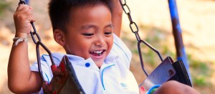
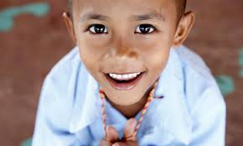
Welcome to Yaowawit School

Slide 2
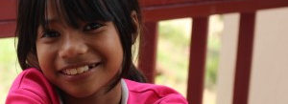
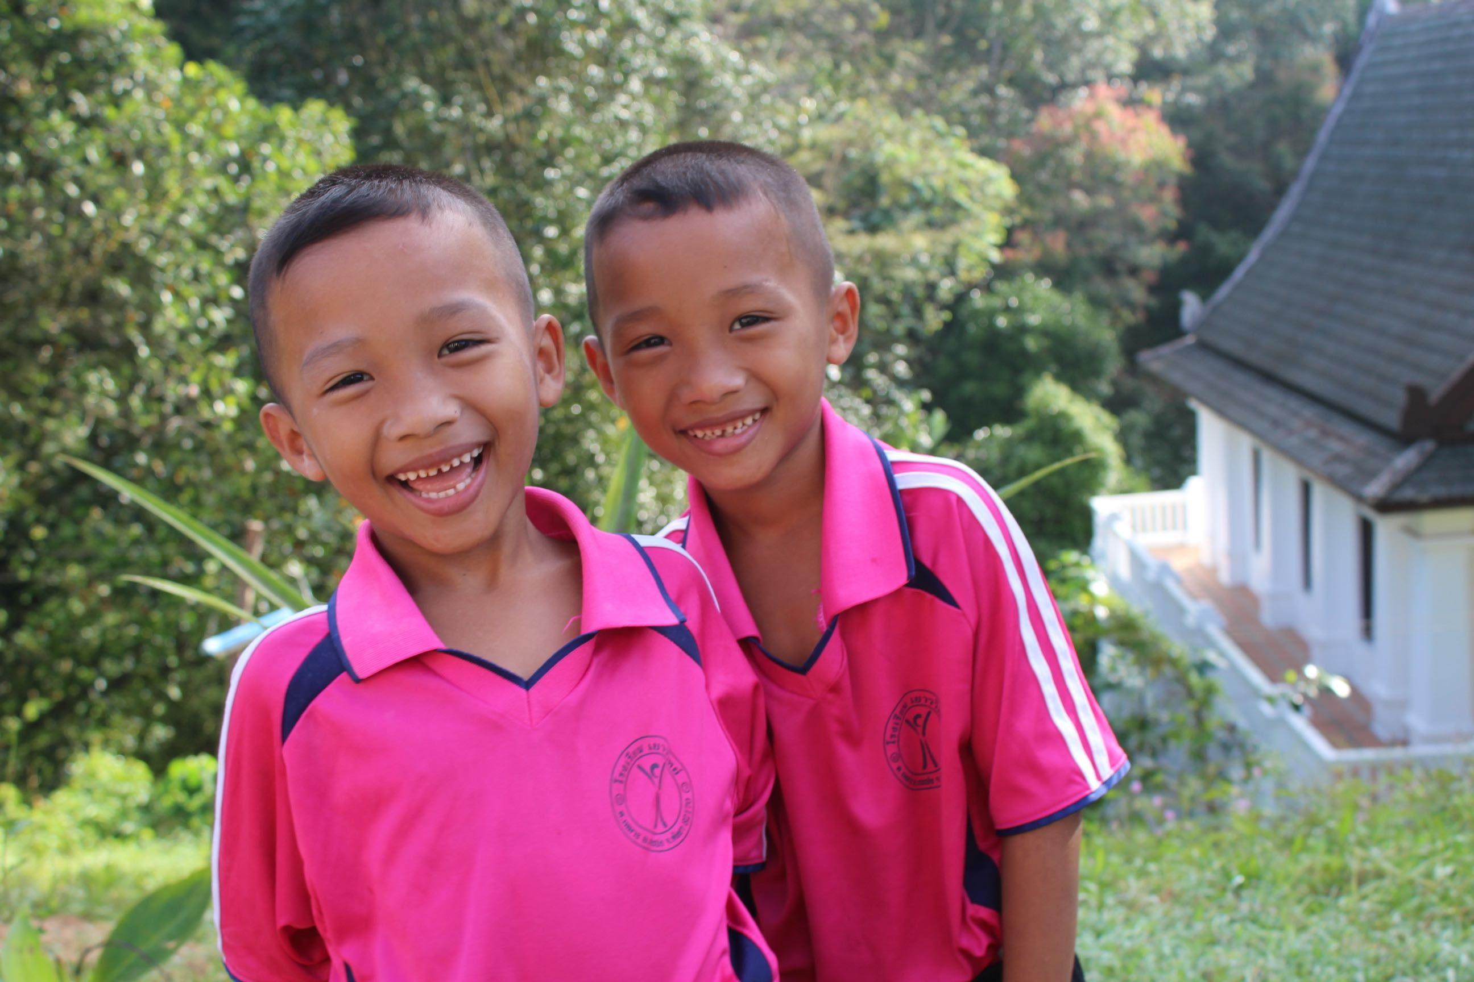
Combining Education with Sustainability
for a Better Future

Slide 3
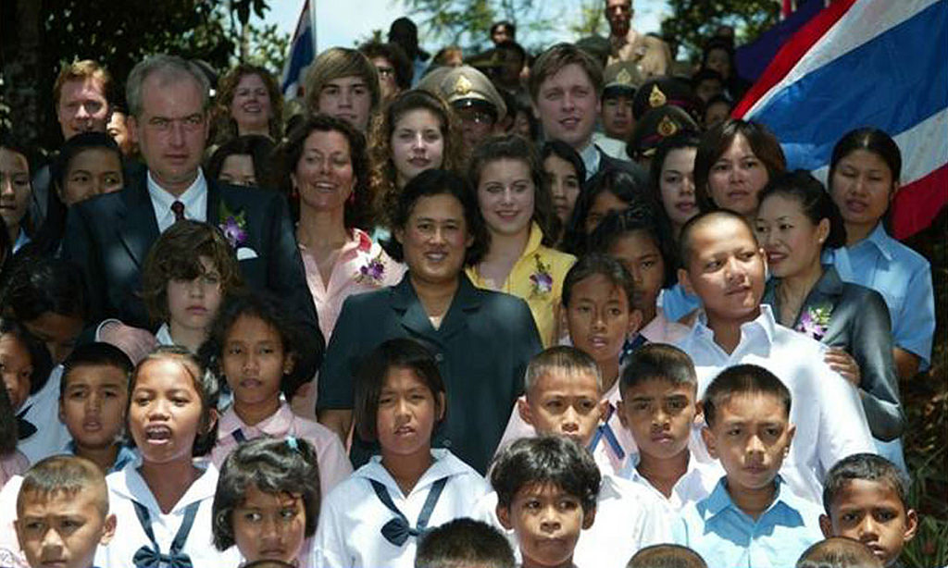
Who we are
We are a government approved welfare boarding school (charity) located in rural Thailand
We opened in April 2006 by HRH Princess Maha Chakri Sirindhorn, who continues to support our philosophy
We were stablished and managed by the Children‘s World Academy Foundation

Slide 4
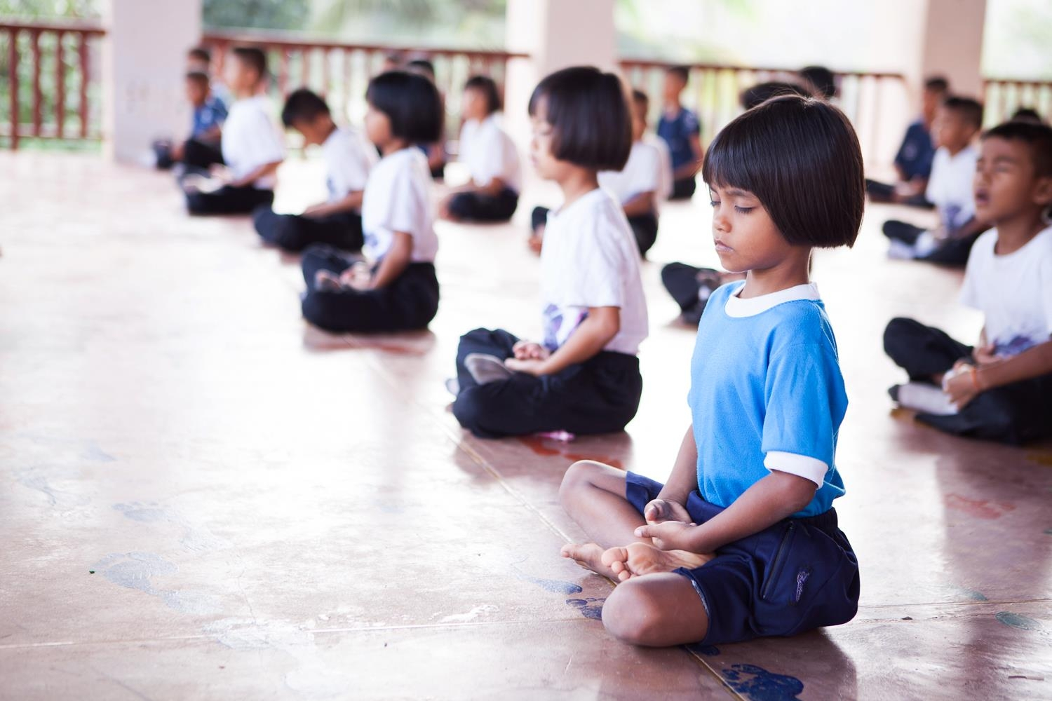
What we do
Yaowawit School is a home for 140 children from underprivileged families. We have created a sanctuary for our children to learn, grow and thrive in while they gain a quality education. We empower our children.
We believe in the potential of each child to break free of their pasts and reach their goals. Each child broken free of poverty now will influence their own families and communities in the future, improving the lives of everyone.

Slide 5
Our philosophy
Rural subsistence living
Low personal income
Local schools inaccessible
Lack of education
No job opportunities
Yaowawit School
Quality education (including life-skill training) that is affordable for children from underprivileged families.
The Poverty Cycle
Better further education and job opportunities.

Slide 6
Our Mission
The Yaowawit School is a community where the well-being and care of all people is our highest mission.
We pledge to provide an excellent life skills education, which helps children to become open-minded, confident, caring, and happy human beings.
Yaowawit School Kapong benefits its neighborhood, and makes a positive difference in everybody's lives.

Slide 7
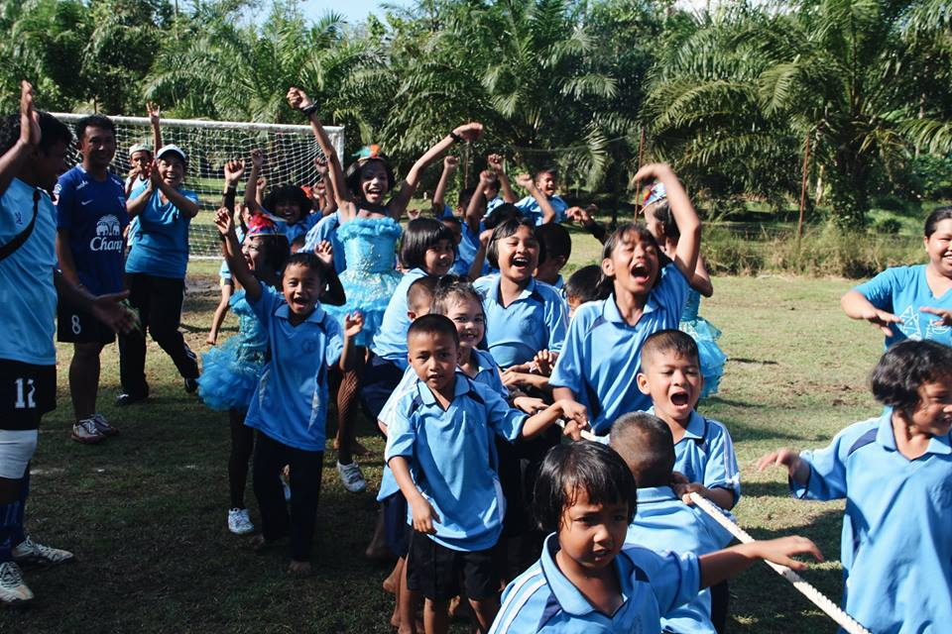
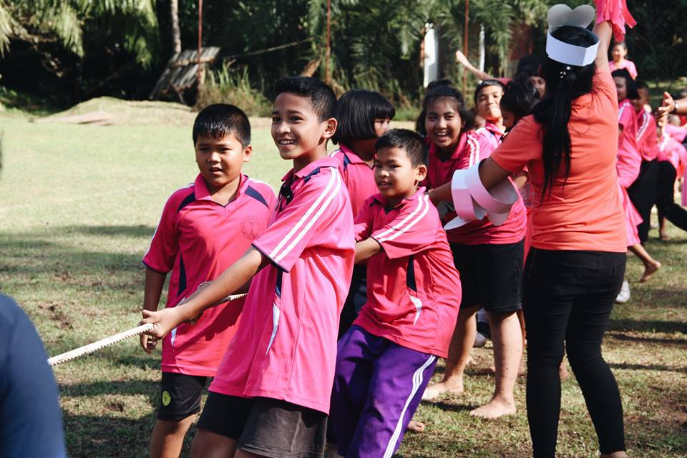
140 children aged 3-18
from some of Southern Thailand’s most underprivileged families

Slide 8
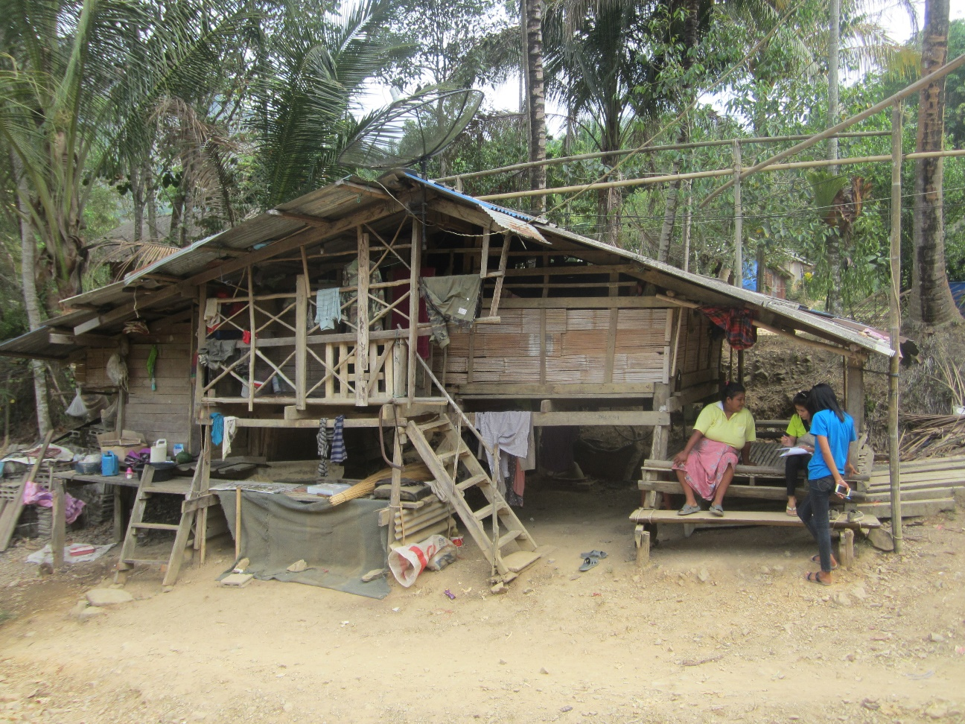
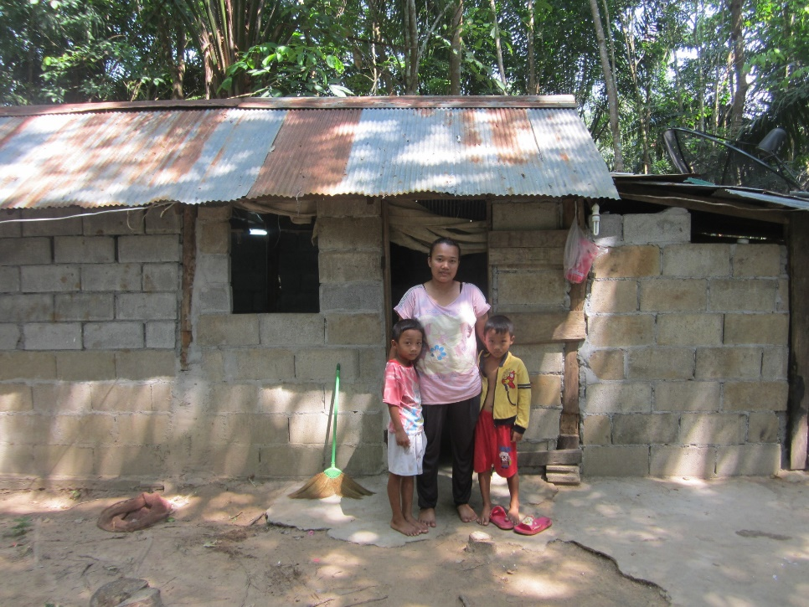
Visits student’s home
Our resources
Each long holiday, our staff visit the home of each and every family who has a child at Yaowawit School to understand their background

Slide 9
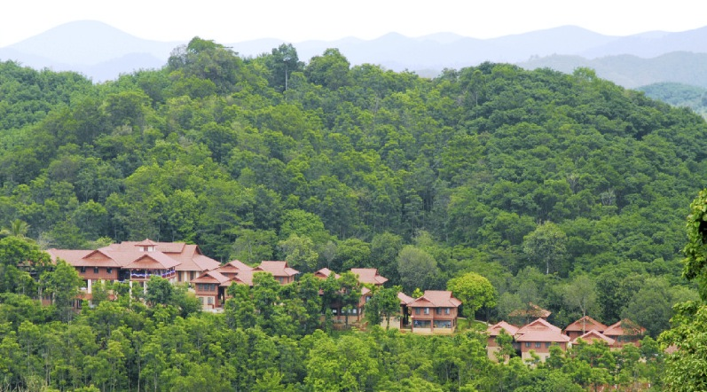
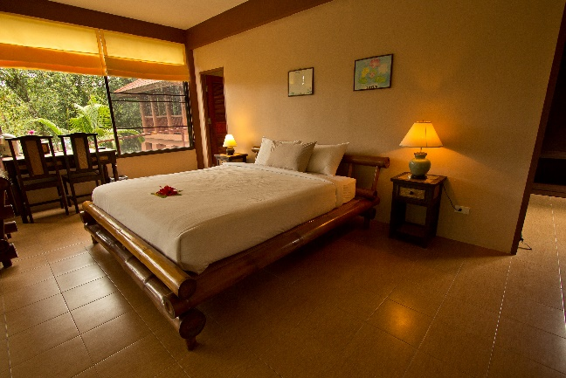
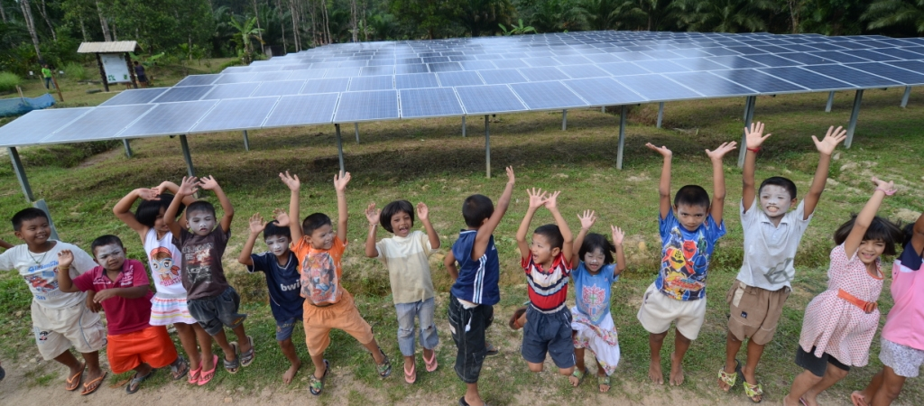
Our resources
A school for kindergarten & primary years
12 teachers & 5 international volunteers
Boarding facilities, including for high school students (who attended Yaowawit primary school and now go to local high schools)
A meditation centre and temple
Yaowawit Lodge (Yaowawit-Pre-Vocational-Hospitality-Academy)
70 rai of organic farm (for farming life skill training)
Solar panels to create renewable energy
(which covers 35-50% of our energy needs)

Slide 10
Integrated curriculum
Life Skills & Vocational
Education
English
Media & IT
Hospitality
Farming
Entrepreneurship
National Thai Curriculum
Taught throughout
Kindergarden and
Primary School
Social &
Personal Development
Critical Thinking
Creativity
Self Discipline
Team Work
Buddhist Values

Slide 11
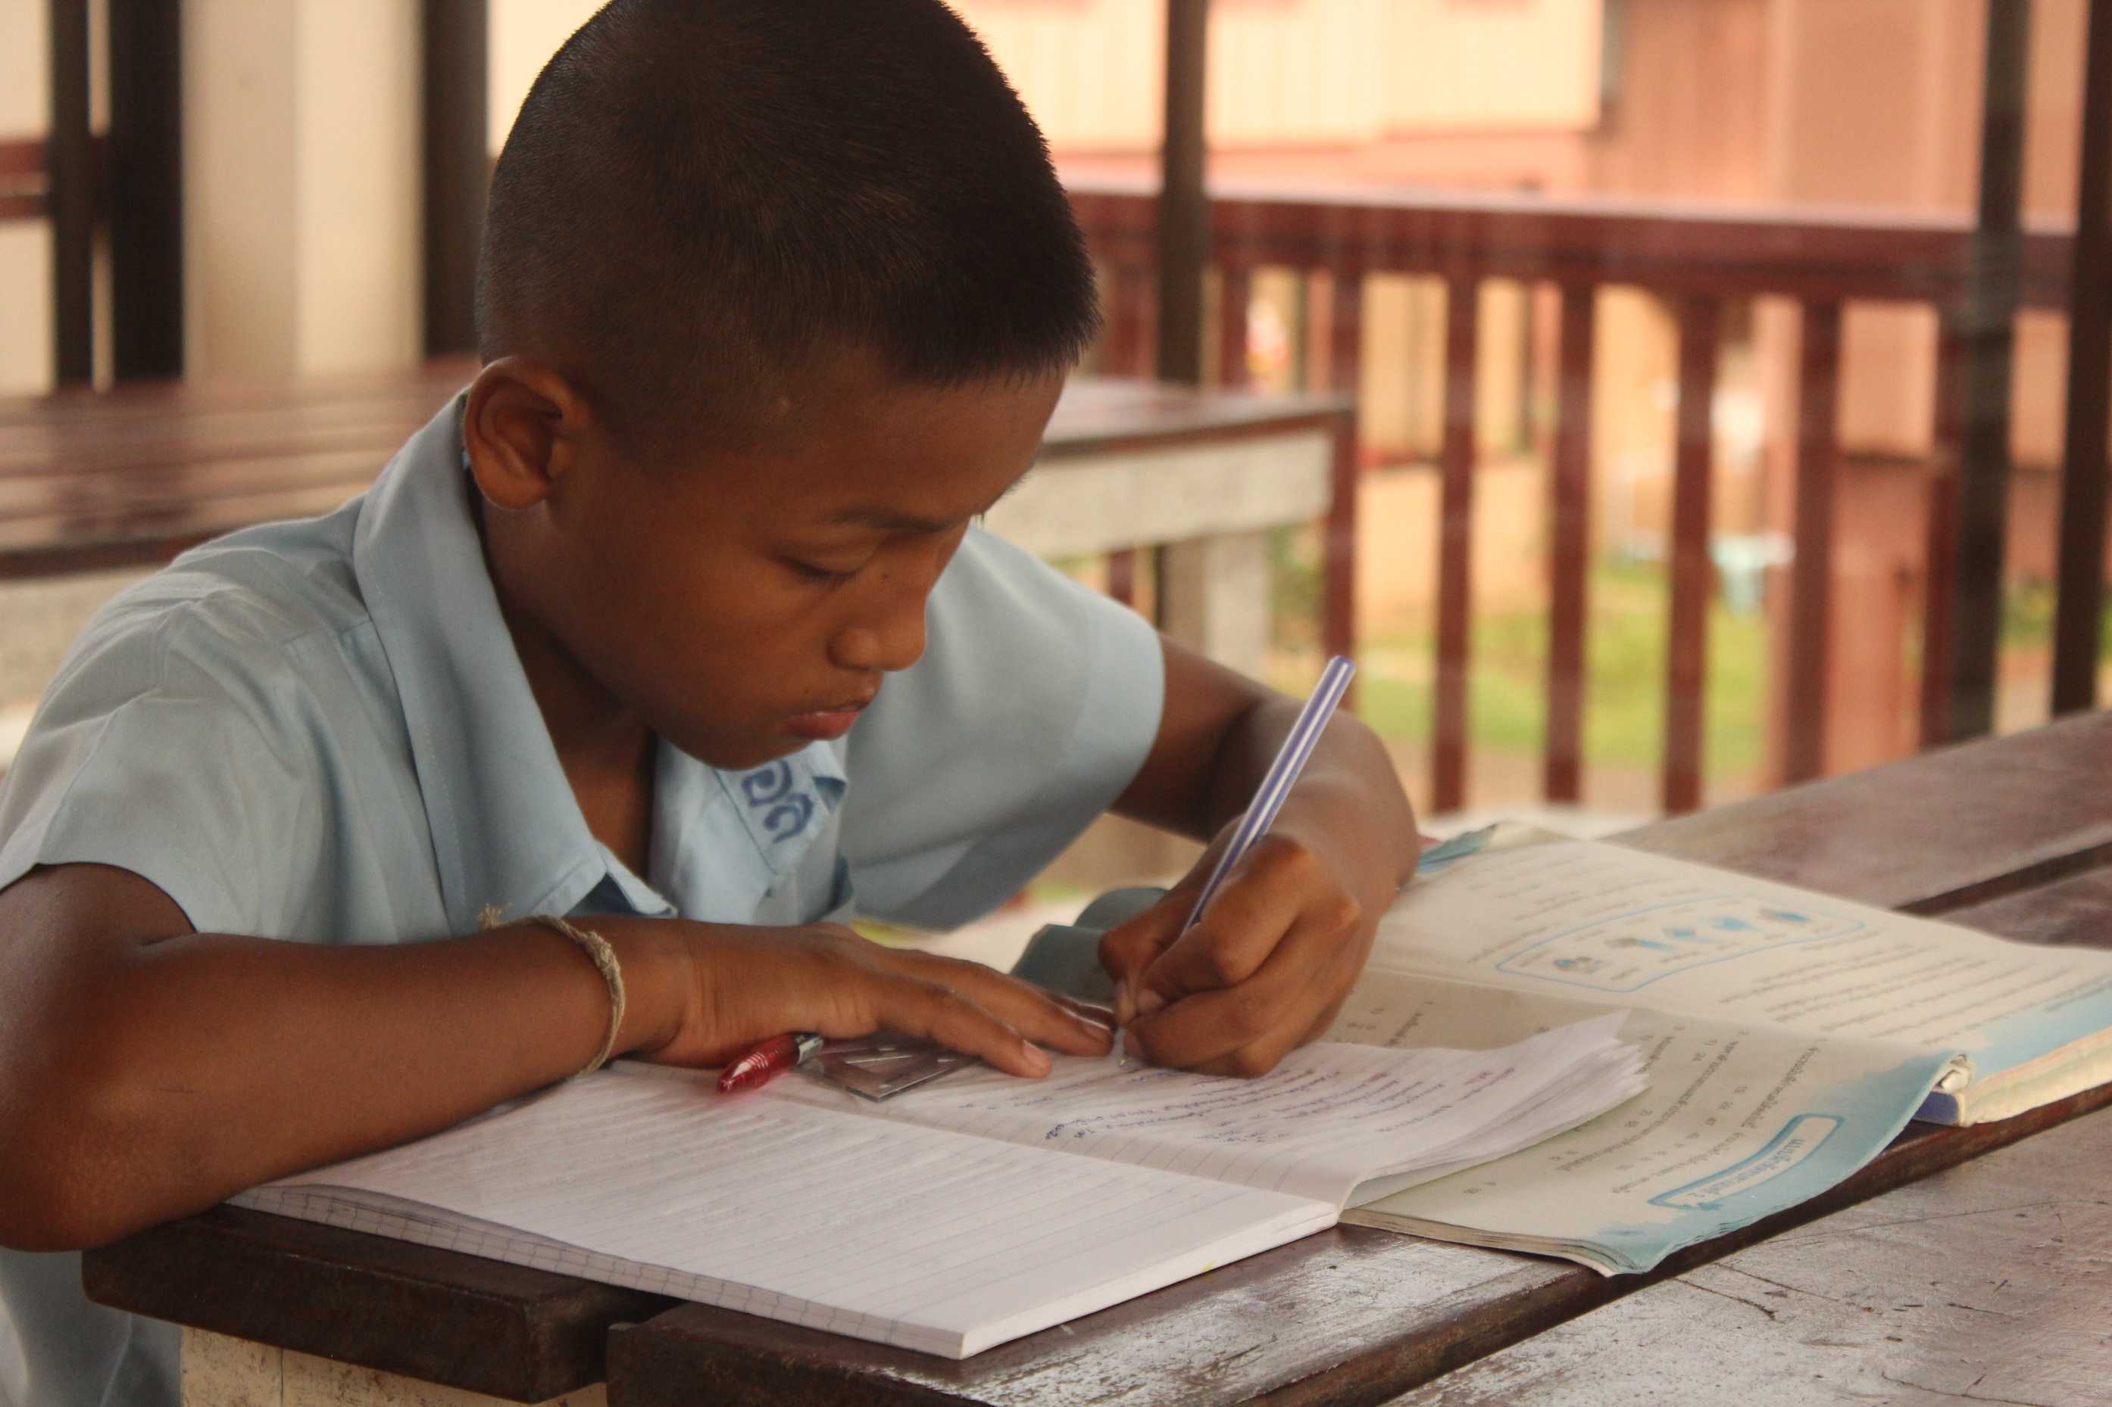
Education at Yaowawit
We provide a holistic education, based on the Thai curriculum but broadened to include the life skills our children need to become healthy, happy and caring individuals, unlocking each child’s full potential and preparing them for their futures. We are at the forefront of education in Thailand, making classes as interactive and connected to the real-world as possible, acting as a model for other schools. One way we do this is through our Pre-Vocational Education where our students are able to develop practical skills in addition to academic skills through hands-on level-appropriate activities in an actual working environment. We also have a strong English programme in our school which increases our student’s opportunities for work and study both in Thailand and abroad.

Slide 12
Goals & Aspirations
Breaking the poverty cycle through education
To provide our children with a quality education (including life-skills training and a strong English language programme) and empower our students to take control of their own futures
To create a model pre-vocational education training programme with vocational schools and businesses, which can be replicated in Thailand and around the world
To become 50% self-funding by 2018 through our Hospitality Learning Centre, organic farming and creating Yaowawit gifts and products
To educate people about social and cultural diversity and inspire them to make a difference
To practice environmental sustainability

Slide 13
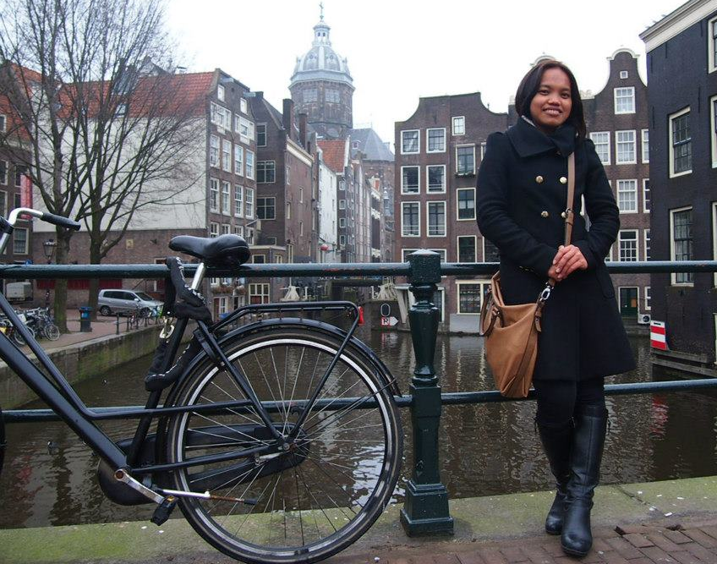
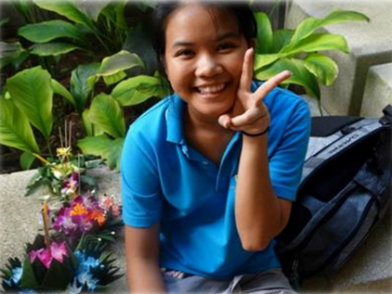
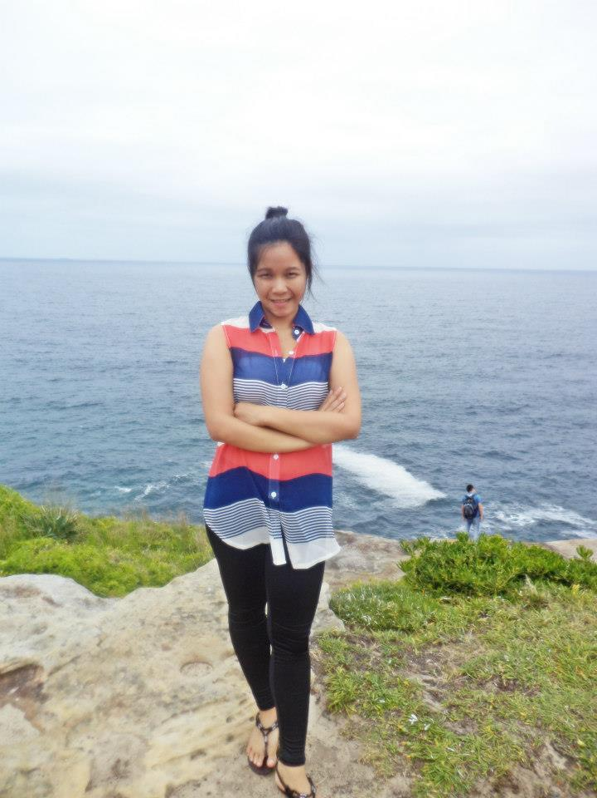
Giving opportunities
June is currently living in The Netherlands, where she is studying international business on a full scholarship at Rotterdam University. The scholarship is very competitive – only one person is selected from each province in Thailand.
Nid’s excellent grades earned her a full scholarship to Phuket International Academy (soon to become a United World College) where she is now working to complete high school.
After graduating, Priar got a scholarship to spend 6 months in Australia to improve her English. She now has a well-paid job in a large hotel in Khao Lak and is saving with the intention of studying hospitality.
Phang Nga Technical College granted 5 of our students with full scholarships to attend their school.

Slide 14
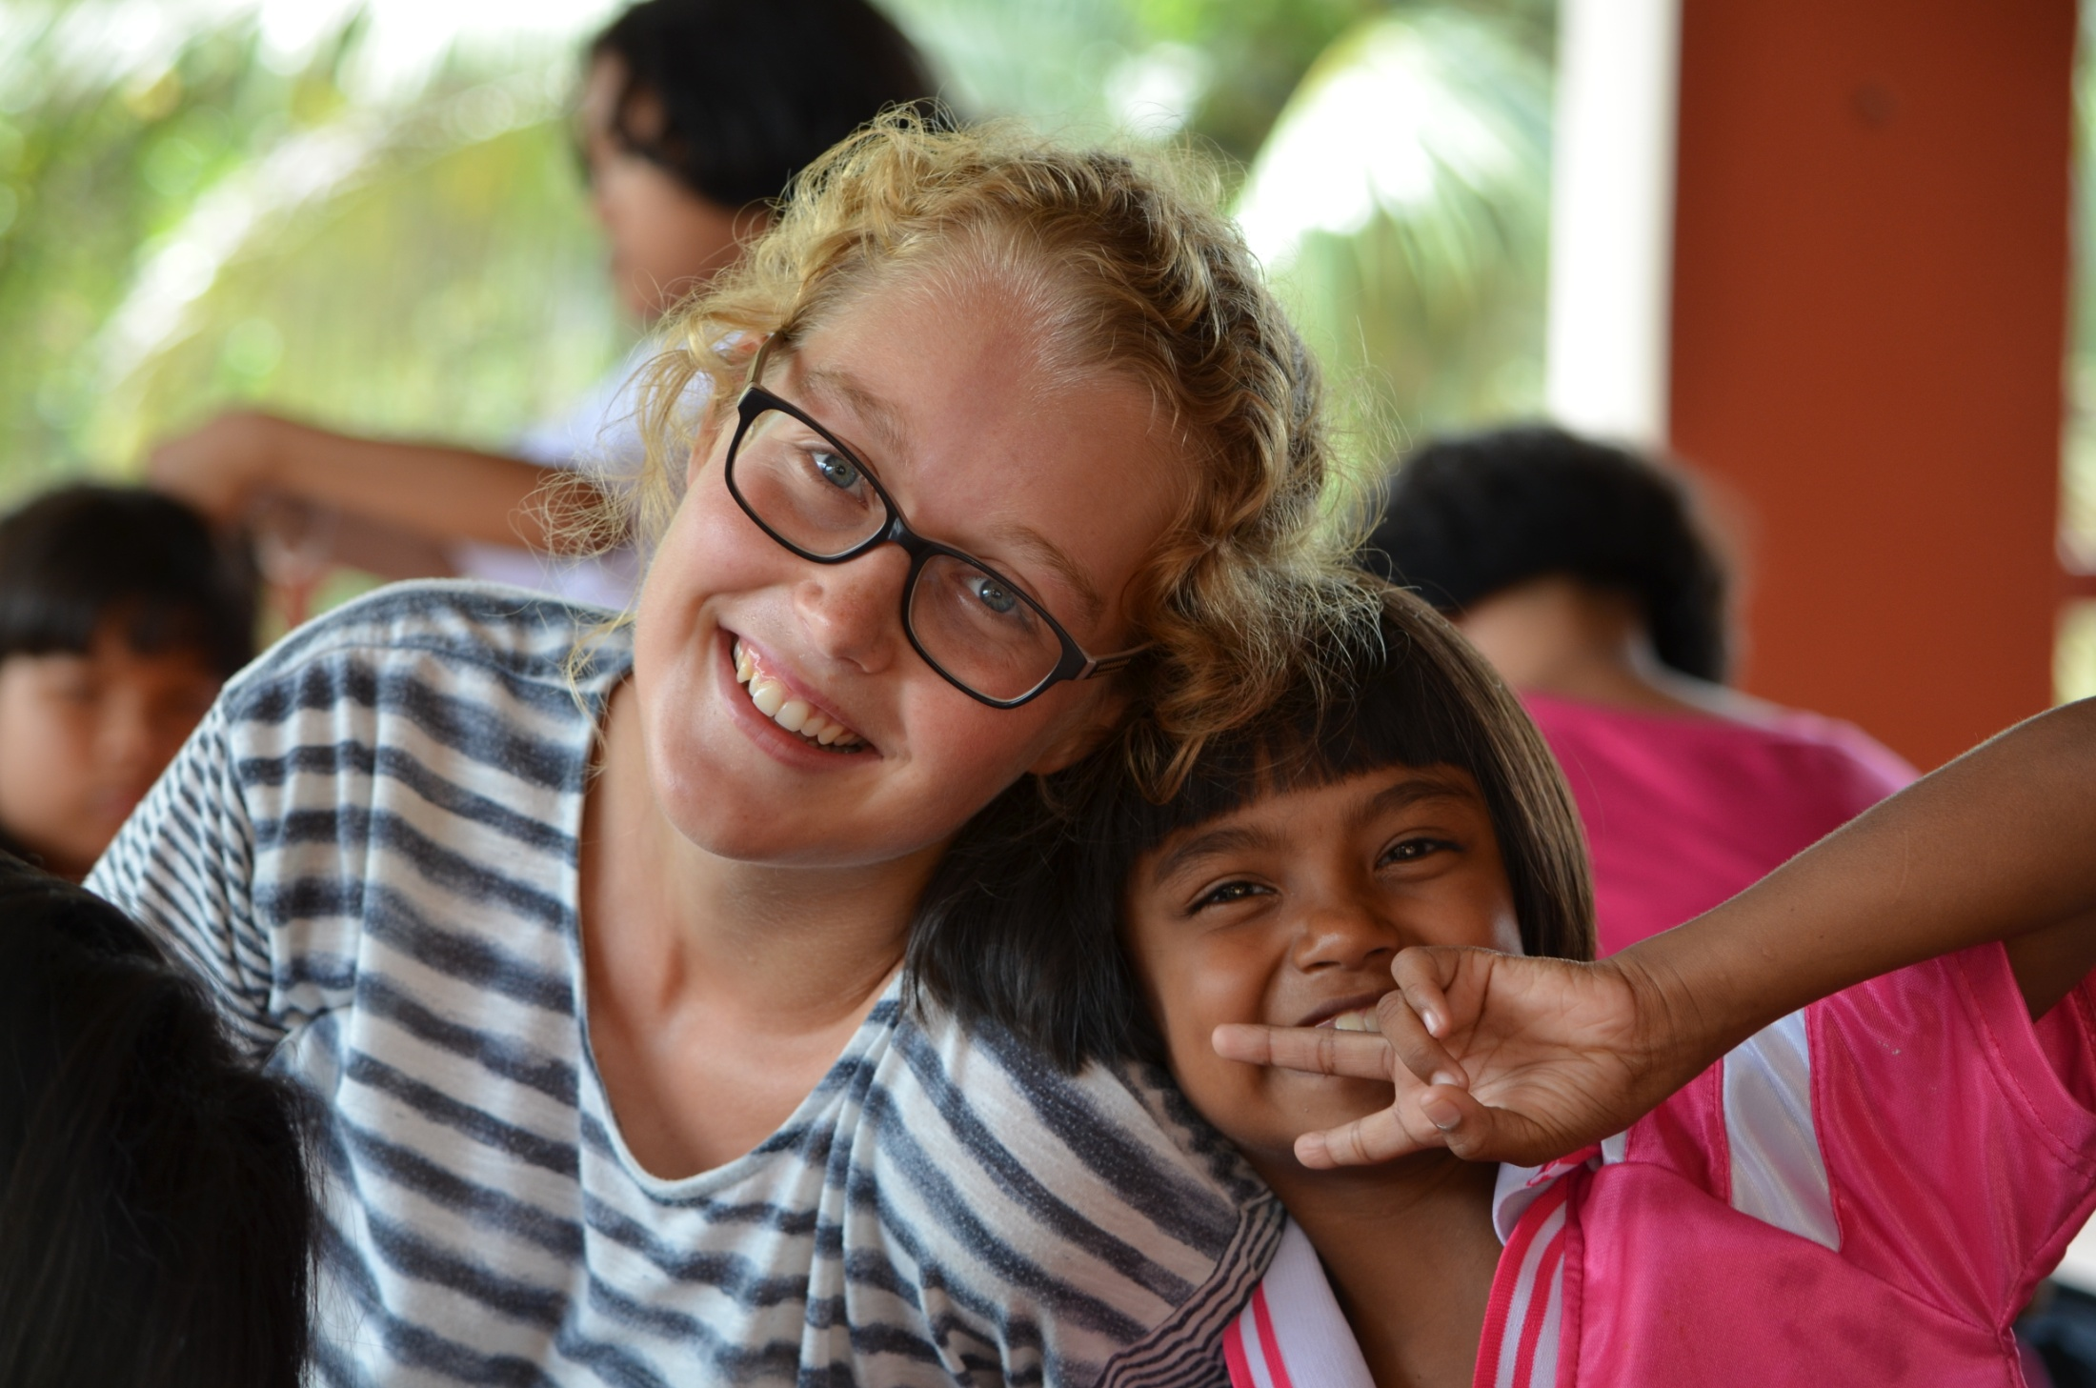
Ways to get involved
Many of the projects that were started in response to the tsunami have now perished due to the expenses involved. Fortunately, Yaowawit School was founded with the idea of long-term sustainability in mind. Our farm and lodge were constructed in order to off-set some of these costs. However, to be able to continue helping our children we require the support of companies, international schools and individuals.
Become a partner
Stay at our lodge
Donate to us
Sponsor a child
Volunteer with us
Share our story

Slide 15
Thank you very much for
your attention
Yaowawit School 29/55 Moo 1, Mao, Kapong, Phang Nga 82170, Thailand +66 (0) 848 521 809 | website: www.yaowawit.org | Email: info@yaowawit.org

